Slide 1
Topic 3.3
Dynamic Programming

Slide 2
Approach
Dynamic Programming is also used in optimization problems. Like divide-and-conquer method, Dynamic Programming solves problems by combining the solutions of sub problems.
Dynamic Programming algorithm solves each sub-problem just once and then saves its answer in a table, thereby avoiding the work of re-computing the answer every time.
Two main properties of a problem suggest that the given problem can be solved using Dynamic Programming. These properties are overlapping sub-problems and optimal substructure.

Slide 3
Dynamic Programming also combines solutions to sub-problems. It is mainly used where the solution of one sub-problem is needed repeatedly. The computed solutions are stored in a table, so that these don’t have to be re-computed.
For example, Binary Search does not have overlapping sub-problem. Whereas recursive program of Fibonacci numbers have many overlapping sub-problems.

Slide 4
A given problem has Optimal Substructure Property, if the optimal solution of the given problem can be obtained using optimal solutions of its sub-problems.
For example, the Shortest Path problem has the following optimal substructure property − If a node x lies in the shortest path from a source node u to destination node v, then the shortest path from u to v is the combination of the shortest path from u to x, and the shortest path from x to v. The standard All Pair Shortest Path algorithms like Floyd-Warshall and Bellman-Ford are typical examples of Dynamic Programming.

Slide 5
Dynamic Programming algorithm is designed using the following four steps:
1. Characterize the structure of an optimal solution.
2. Recursively define the value of an optimal solution.
3. Compute the value of an optimal solution, typically in a bottom-up fashion.
4. Construct an optimal solution from the computed information.

Slide 6
Divide & Conquer Method | Dynamic Programming
It deals (involves) three steps at each level of recursion: Divide the problem into a number of sub problems. Conquer the sub problems by solving them recursively. Combine the solution to the sub problems into the solution for original sub problems. | It involves the sequence of four steps: o Characterize the structure of optimal solutions. o Recursively defines the values of optimal solutions. o Compute the value of optimal solutions in a Bottom-up minimum. o Construct an Optimal Solution from computed information.
It is Recursive. | It is non Recursive.
t does more work on sub problems and hence has more time consumption | It solves sub problems only once and then stores in the table.
It is a top-down approach. | It is a Bottom-up approach
In this sub problems are independent of each other. | In this sub problems are interdependent.
For example: Merge Sort & Binary Search etc. | For example: Matrix Multiplication.

Slide 7
Applications of dynamic programming
0/1 knapsack problem
All pair Shortest path problem
Reliability design problem
Longest common subsequence (LCS)
Flight control and robotics control
Time-sharing: It schedules the job to maximize CPU usage

Slide 8
0/1 Knapsack Problem
Knapsack is basically means bag. A bag of given capacity. We want to pack n items in your luggage. o The ith item is worth vi dollars and weight wi pounds. o Take as valuable a load as possible, but cannot exceed W pounds. o vi wi W are integers.
1. W ≤ capacity 2. Value ← Max

Slide 9
Unbounded Knapsack (Repetition of items allowed)
Unbounded Knapsack Problem. In this case, an item can be used infinite times. This problem can be solved efficiently using Dynamic Programming.
N is always positive i.e greater than zero

Slide 10
EXAMPLE
Input : W = 100 val[] = {1, 30} wt[] = {1, 50} Output : 100 There are many ways to fill knapsack. 1) 2 instances of 50 unit weight item. 2) 100 instances of 1 unit weight item. 3) 1 instance of 50 unit weight item and 50 instances of 1 unit weight items. We get maximum value with option 2. Input : W = 8 val[] = {10, 40, 50, 70} wt[] = {1, 3, 4, 5} Output : 110 We get maximum value with one unit of weight 5 and one unit of weight 3.

Slide 11
Bounded Knapsack Problem
Given N items, each item having a given weight w_{i} and a value v_{i}, the task is to maximize the value by selecting a maximum of K items adding up to a maximum weight W.

Slide 12
0/1 Knapsack Problem
We are given N items where each item has some weight (w_{i}) and value (v_{i}) associated with it. We are also given a bag with capacity W. The target is to put the items into the bag such that the sum of values associated with them is the maximum possible.

Slide 13
Fractional Knapsack Problem
Given the weights and values of N items, put these items in a knapsack of capacity W to get the maximum total value in the knapsack. In Fractional Knapsack, we can break items for maximizing the total value of the knapsack.

Slide 14
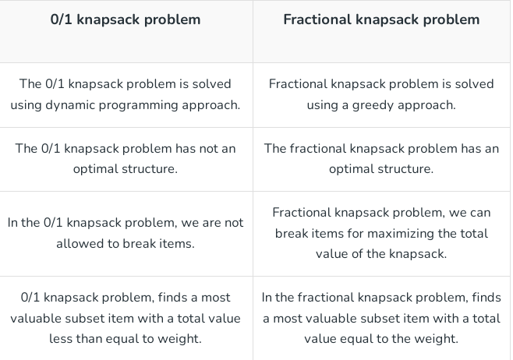

Slide 15
Question?
You are given a knapsack that can carry a maximum weight of 60. There are 4 items with weights {20, 30, 40, 70} and values {70, 80, 90, 200}. What is the maximum value of the items you can carry using the knapsack?
Solution: The maximum value you can get is 160. This can be achieved by choosing the items 1 and 3 that have a total weight of 60.

Slide 16
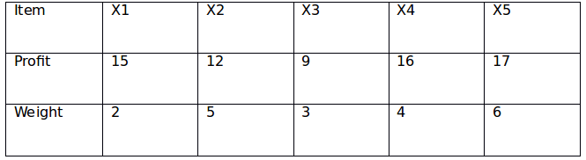
Consider the following instance of knapsack problem: The maximum weight of 12 is allowed in the knapsack. Find the value of maximum profit with the optimal solution of the fractional knapsack problem.

Slide 17
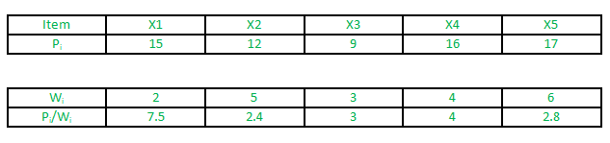
Solution:
Decreasing order of P i /W i is X1, X4, X3, X5, X2 X1 --> profit = 15 and weight = 2 Including X4 --> profit = 15 + 16 and weight = 2 + 4 = 6 Including X3 --> profit = 40 and weight = 9 Now weight left = 3 Weight of X5 = 6 --> half of X5 can be included. Profit = 40 + 17/2 = 48.5.

Slide 18
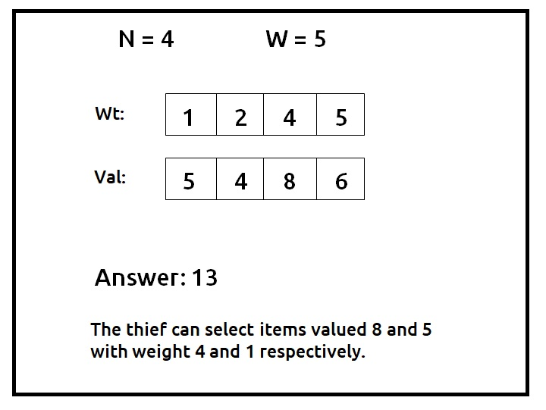
2. A thief wants to rob a store. He is carrying a bag of capacity W. The store has ‘n’ items. Its weight is given by the ‘wt’ array and its value by the ‘val’ array. He can either include an item in its knapsack or exclude it but can’t partially have it as a fraction. We need to find the maximum value of items that the thief can steal.
Solution:

Slide 19
Bellman Ford Algorithm
The Bellman-Ford algorithm is a way to find single source shortest paths in a graph with negative edge weights (but no negative cycles). The second for loop in this algorithm also detects negative cycles.
The first for loop relaxes each of the edges in the graph n − 1 times. We claim that after n − 1 iterations, the distances are guaranteed to be correct. Overall, the algorithm takes O(mn) time.
Dynamic Programming is used in the Bellman-Ford algorithm. It begins with a starting vertex and calculates the distances between other vertices that a single edge can reach. It then searches for a path with two edges, and so on. The Bellman-Ford algorithm uses the bottom-up approach.

Slide 20
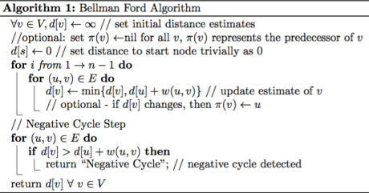

Slide 21
Bellman-Ford detects negative cycles, i.e. if there is a negative cycle reachable from the source s, then for some edge (u, v), dn−1(v) > dn−1(u) + w(u, v).
If the graph has no negative cycles, then the distance estimates on the last iteration are equal to the true shortest distances. That is, dn−1(v) = δ(s, v) for all vertices v.

Slide 22
Why Should You Be Cautious With Negative Weights?
When attempting to find the shortest path, negative weight cycles may produce an incorrect result.Shortest path algorithms, such as Dijkstra's Algorithm that cannot detect such a cycle, may produce incorrect results because they may go through a negative weight cycle, reducing the path length.

Slide 23
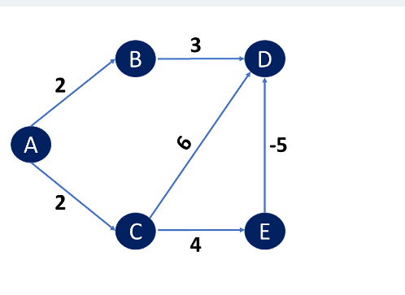
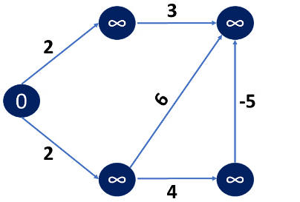
Example
Choose path value 0 for the source vertex and infinity for all other vertices.

Slide 24
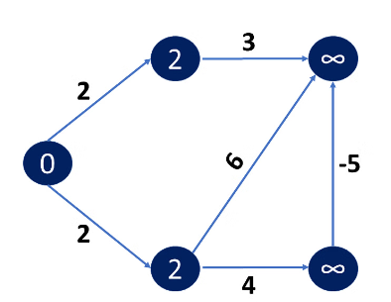
If the new calculated path length is less than the previous path length, go to the source vertex's neighbouring Edge and relax the path length of the adjacent Vertex.

Slide 25
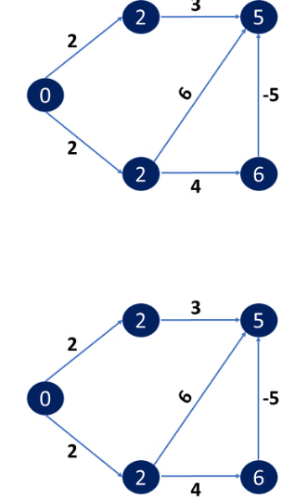
This procedure must be repeated V-1 times, where V is the number of vertices in total. This happened because, in the worst-case scenario, any vertex's path length can be changed N times to an even shorter path length.

Slide 26
This procedure must be repeated V-1 times, where V is the number of vertices in total. This happened because, in the worst-case scenario, any vertex's path length can be changed N times to an even shorter path length.

Slide 27
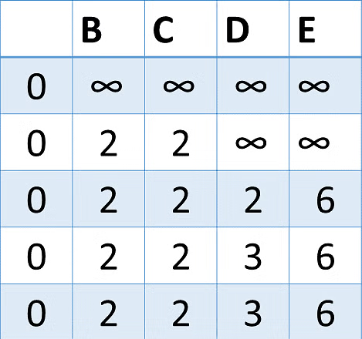
As a result, after V-1 iterations, you find your new path lengths and can determine in case the graph has a negative cycle or not.

